Slide 1
MCB 638
Live Session 4
Monday night

Slide 2
Agenda for Live Session 4
Process Learnings
2. Hypothesis Test Example
3. Chi Square
4. Wrap-up/What’s next/Feedback

Slide 3
Process Learnings/Reminders
If you have difficulties with LaunchPad, please try a different browser - Chrome. And be sure you have Flash enabled. If you still need help, contact LaunchPad Technical Support at 800-936-6899 Also, be sure to watch the videos before attempting to answer the questions.
If you have missed a Live Session, please watch the Recording. Recordings can be found on the screen where you find the buttons to click to join our Live Sessions. They are on the bottom of that screen. Choose the version you prefer – possibly the 3rd one includes the PowerPoint slides.
Reminder - You may only miss one Live session per university policy
Please don’t hesitate to attend Office Hours. It is held on Thursday, from 9-10 pm EST or reach out by email if you have any questions. No appointment needed, just first come - first served.

Slide 4
Sigma Quality Level (SQL)
You have a process where it is possible to have 5 different defects per item. This month you have made 2100 products and discovered 256 total defects. What is the SQL for the overall process?
1. Defect opportunities per unit: D = 5
2. Units produced per month: U = 2100
3. Total possible defects per month: D × U = 10,500
4. Total actual defects for that month: A = 256
5. Defects per million opportunities (DPMO): 256/10,500 = .024
.024* 1,000,000 = 24,380
6. SQL value (from SQL table): ?- Let’s look it up
Note that any time frame would work as long as you use the same timeframe throughout the above Steps (week, year, 2 months, etc.)

Slide 5
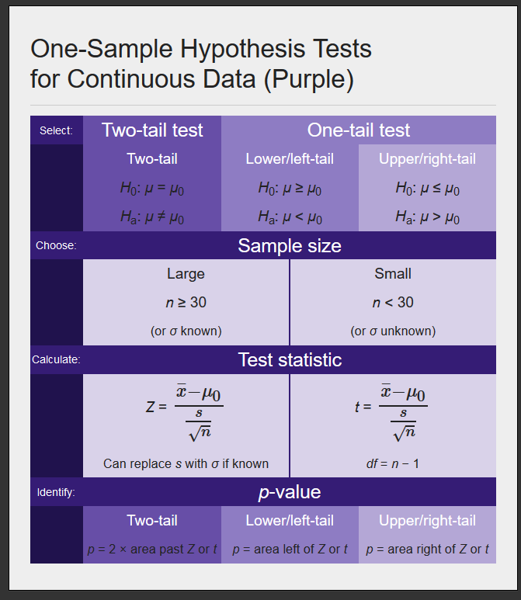
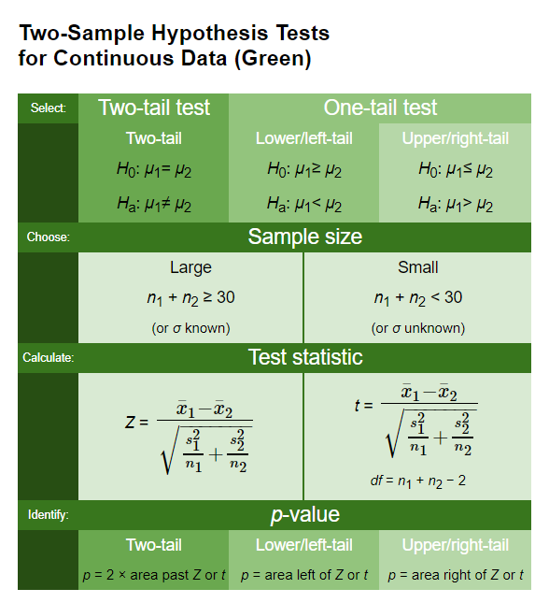
Hypothesis Tests for Continuous Data

Slide 6
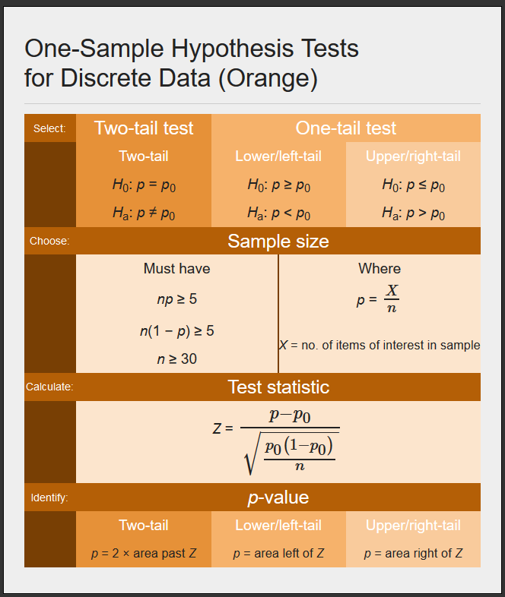
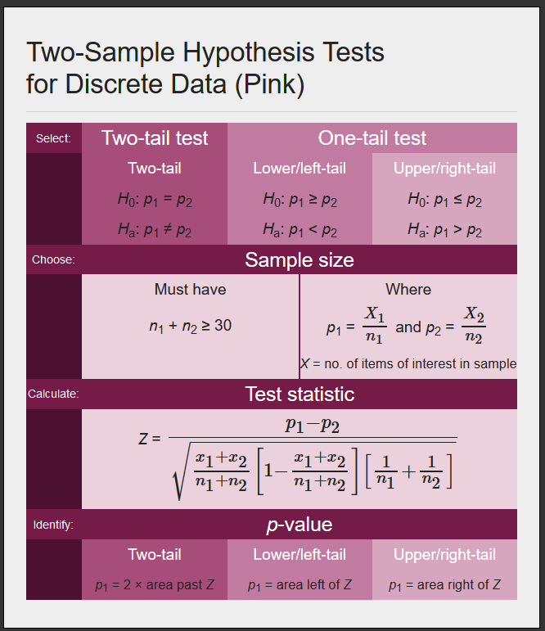
Hypothesis Tests for Discrete Data

Slide 7
Hypothesis Test Tips
The = sign always goes in Ho
You would never state Ha: u>= 10
It is OK to have “not equal to” in Ha
The same numerical # must be in Ho and Ha
You would never state Ho: u <= 10, Ha: u>12

Slide 8
Hypothesis test example
In 2014, the mean annual car insurance premium for a Porsche Panamera turbo-S was $3000. Suppose that a random sample of nine such Porsches taken this year has a mean car insurance premium of $3120. Assume standard dev = $600 and assume that the distribution of premiums is normal. Test whether the population mean premium has increased, using level of significance of alpha = .10

Slide 9
Hypothesis test example
Is the data Discrete or Continuous?
Is it one-sample or two-sample?
Which color chart shall we use?
Will we do a one-tail or two-tail test?

Slide 10
Chi Square
Remember – Chi Square is used with categorical discrete data
χ² test for independence: a hypothesis test used to determine if two variables are related or are statistically independent
Convention:
H₀: Categorical Variable 1 and Categorical Variable 2 are independent (i.e., there is no relationship).
H_{a}: Categorical Variable 1 and Categorical Variable 2 are not independent (i.e., there is a relationship).
Requirement – you must have at least 5 data points in each cell for this tool to be valid.
How it works:
Compares "observed" counts and "expected" counts or frequencies.
Calculate Chi Square. Look it up in table or use Excel to find p.
Compare p to alpha. If p is low, Ho must go.
Does not give direction (positive/negative) or intensity of relationship
All it tells us is if there is a relationship – not directional

Slide 11
Chi Square steps
Write your hypothesis statements
Ho: Purchase of a meal or not and beverage preference are independent (no relationship)
Ha: Purchase of a meal or not and beverage preference are not independent (relationship)
Create your Observed and Expected Tables
Use Excel → CHISQ.TEST p = 4.22109E-50 ~ 0
4. Reach your statistical conclusion:
Select Alpha. We'll pick .05
p is low so reject the null (Ho)
5. State your practical conclusion:
There is a relationship between meal choice and beverage preference
Must have at least 5 in
each cell in the Observed table
for this tool to be valid
Observed |  |  |  |  |  | Expected
 | Coffee | Flavored beverage | Tea | Totals |  |  | Coffee | Flavored beverage | Tea
Purchase a meal | 610 | 220 | 140 | 970 |  | Purchase a meal | 457 | 336 | 178
Does not purchase a meal | 200 | 375 | 175 | 750 |  | Does not purchase a meal | 353 | 259 | 137
Totals | 810 | 595 | 315 | 1720 | <--- N
 |  |  |  |  |  |  | 970 * 810 /1720 = 457

Slide 12
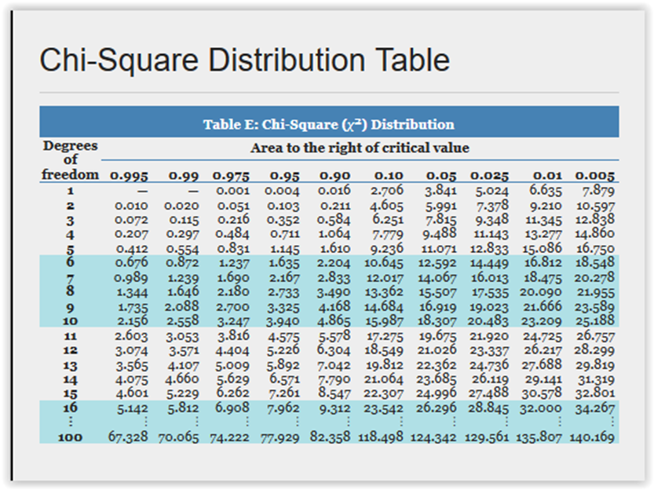
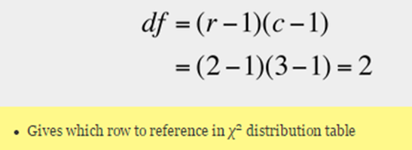
Chi Square steps
Or you can calculate Chi Square for all combinations of rows and columns, sum these numbers and use Table E to find the p value:
df in the left column:
Look for your X ² inside the table 227.38
The table only goes to 10.597
Find your p value in the header row across the top
~0
Chi Square values
in the table
Table E
Probabilities in the
header row

Slide 13
Chi Square Example for class
Some students prefer to study in the morning and others prefer the afternoon or evening. Is one’s grade dependent upon the time of day you study?
We will work on this together in class.

Slide 14
Breakouts

Slide 15
DMAIC
Define
Measure
Description:
Clearly identify the business problem / performance gap (output measure), customer, scope, goals and resources.
Key Concepts:
y = f(x)
Types of data
Descriptive statistics and soft tools
Project:
Complete Problem Definition Worksheet
Tools:
Process map
SIPOC
Descriptive statistics
Thought process map
Affinity diagram
Sigma Quality Level (SQL)
Description:
Validate your measurement system and collect baseline data.
Key Concepts:
Mapping a process/value-stream, forms of waste, measurement error, reproducibility, repeatability
Project:
Identify potential inputs, develop operational definitions, develop data measurement/collection plan, validate measurement system, collect baseline data, calculate SQL.
Tools:
Operational definitions
Kappa
Process map (detailed)
Data measurement plan
Data stratification tree
Histogram
Trend/ line chart
Pareto chart
Fishbone (cause/effect) diagram
Week 1
Week 2

Slide 16
Analyze
Description:
Analyze, describe, and present the data to discover the root cause(s), identify/prioritize critical inputs (x’s), determine the inputs impact on the output.
Key Concepts:
Inferential statistics, common distributions, developing a hypothesis, determining the likelihood some event happens based on a sample (calculating probabilities), Using the normal distribution as the “go to” distribution.
Project:
Write a null and alternative hypothesis statement.
Tools:
Hypothesis testing
Chi-square test for independence
Key Concepts:
Collecting sample data, how confidence intervals and sample size are related.
Project:
Utilize the sample size formula.
Tools:
Confidence intervals.
Key Concepts:
Determining input’s (x) impact on the output (y).
Project:
Use regression to identify relationships between the output (y) and inputs (x’s).
Tools:
Correlation
Simple linear regression
Multiple regression
Scatterplot
Trend/ line chart
Pareto chart
Fishbone (cause/effect) diagram
Week 3 & 4
Week 5
Week 6 &7

Slide 17
What’s next:
Class Assignments | Submit / Post Location | Due Date
Week 5 (Reference: textbook Ch.8 – skip sect. 8.4)
Homework #3: (worth 2 points) LaunchPad Assignments Chapter 8 Practice Quiz (unlimited attempts) | LaunchPad | 3 days after Live Session 5 = Nov 5
Week 6
Quiz #2 (covers Chapters 3,6,8,9,11.2) | Coursework → Assessments | 3 days after Live Session 6 = Nov 12
Project – Check your timeline and be sure you are on track
- Collect data
- Moving into Analyze Phase
Next session – a walk through good and not so good example projects

Slide 18
Questions?

